Slide 1

SARS COVID-19 DETECTION THROUGH AI
CS-691

Slide 2

TEAM MEMBERS

Slide 3

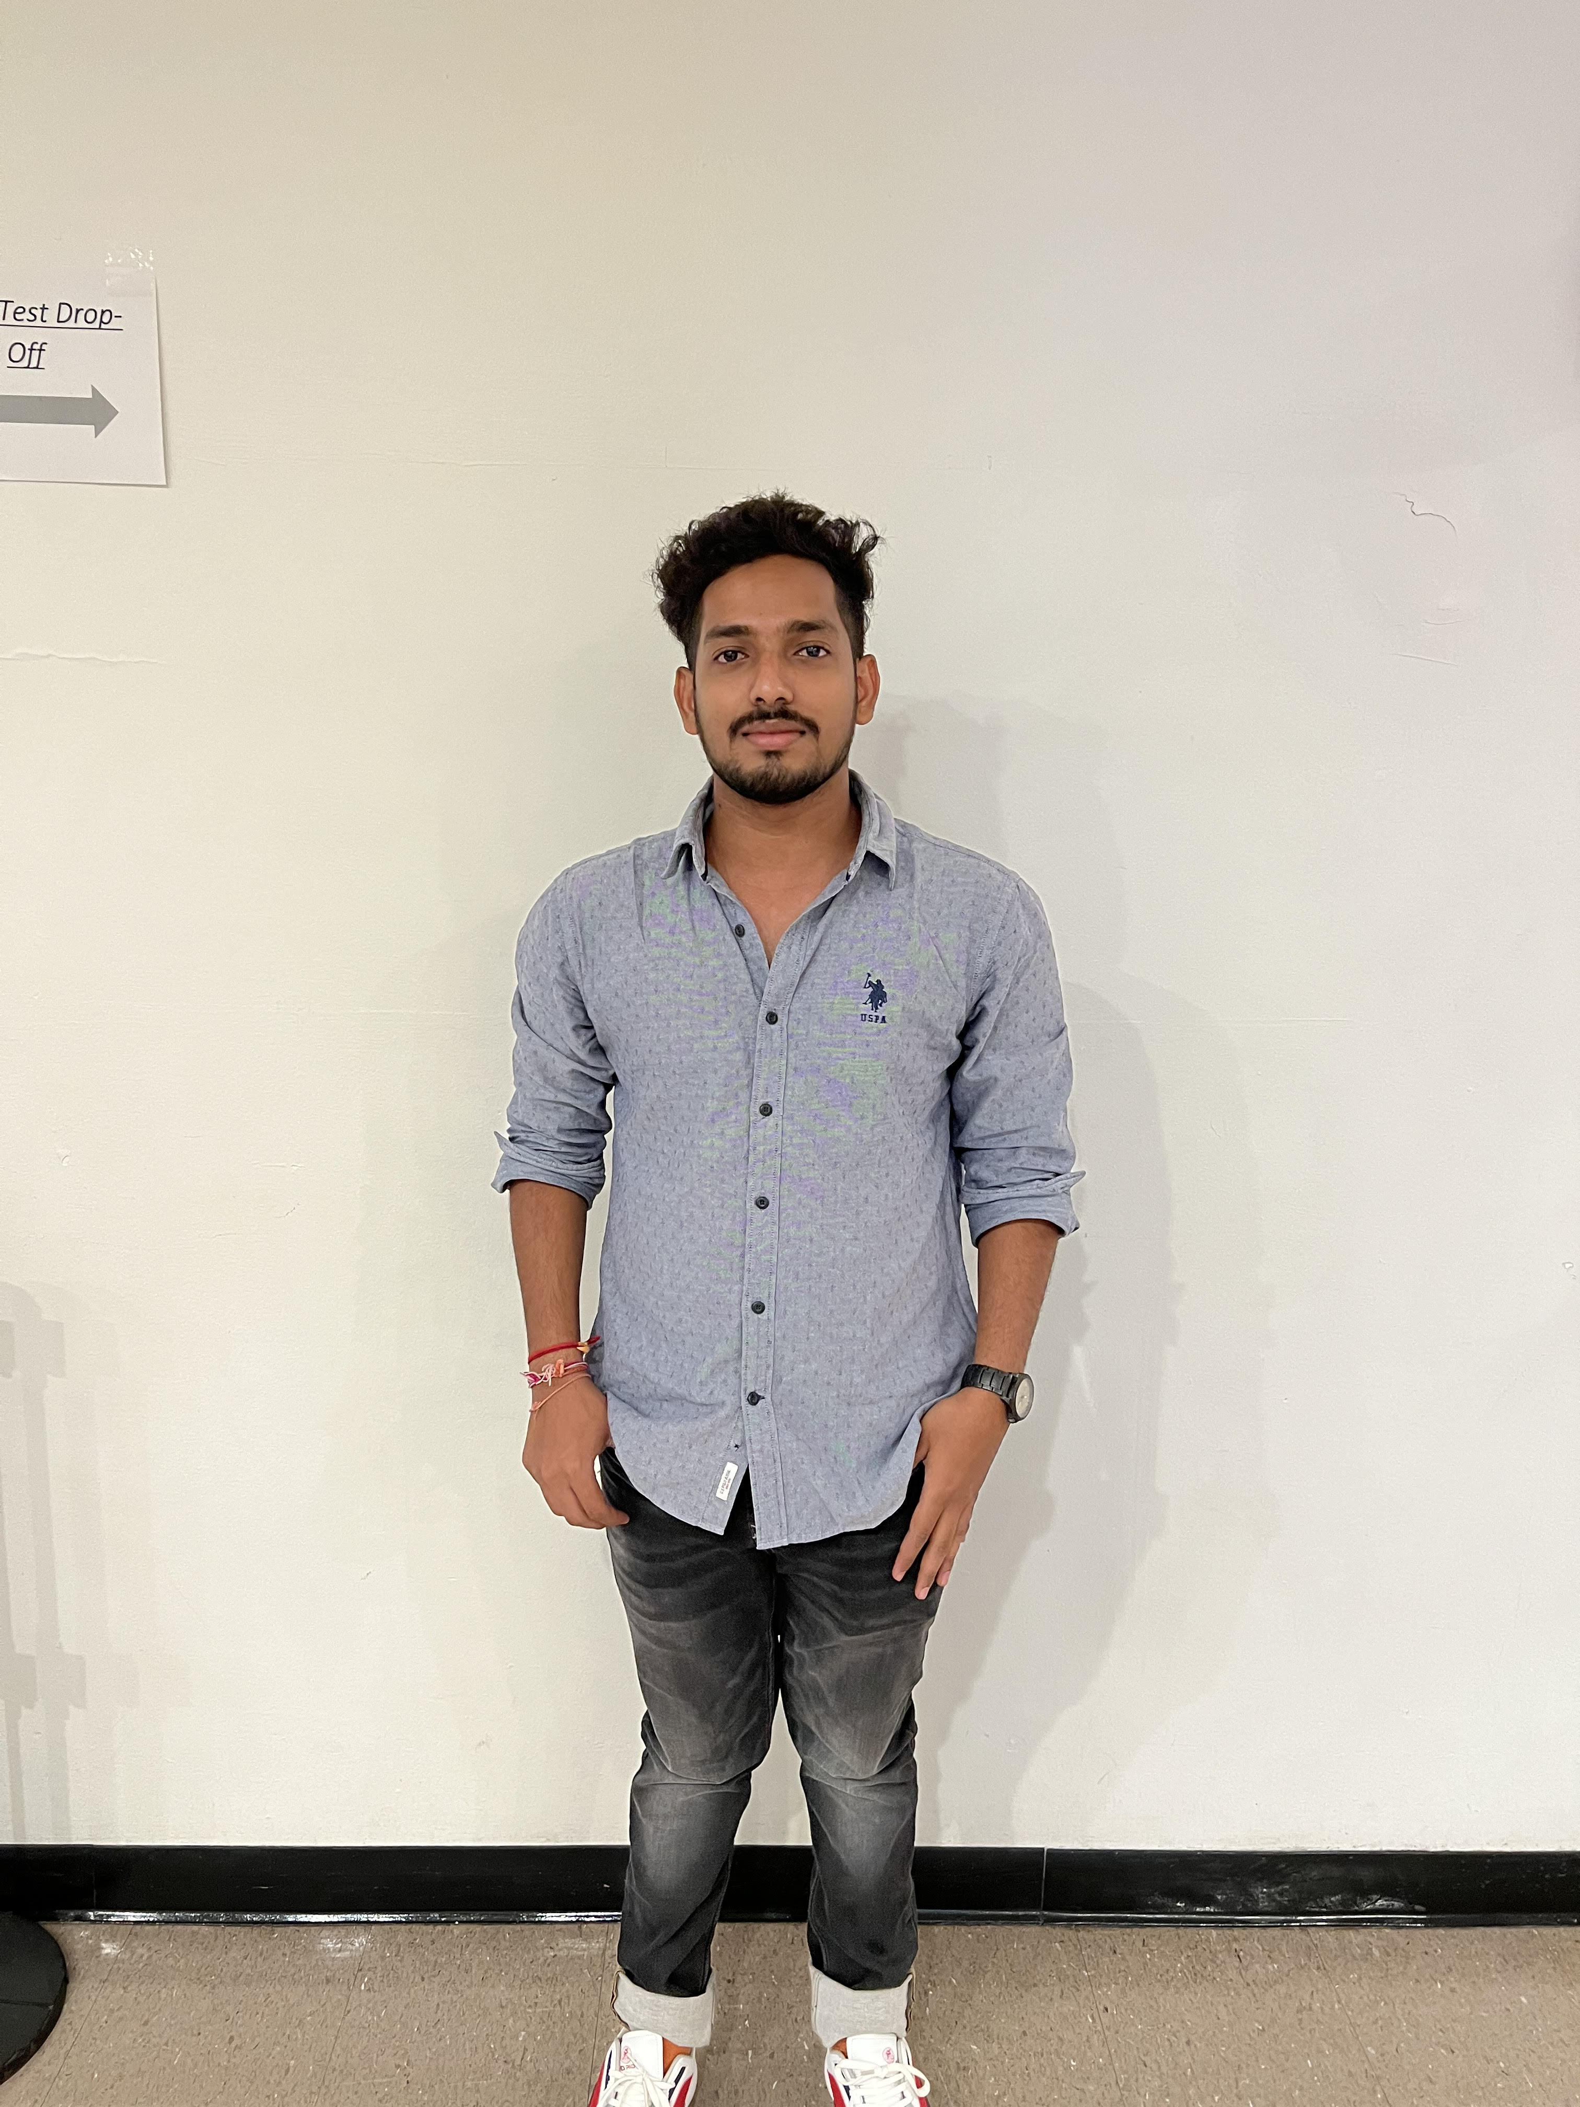
Hanith atluri
(Tester)
Vamshi
(Product manager)

Slide 4


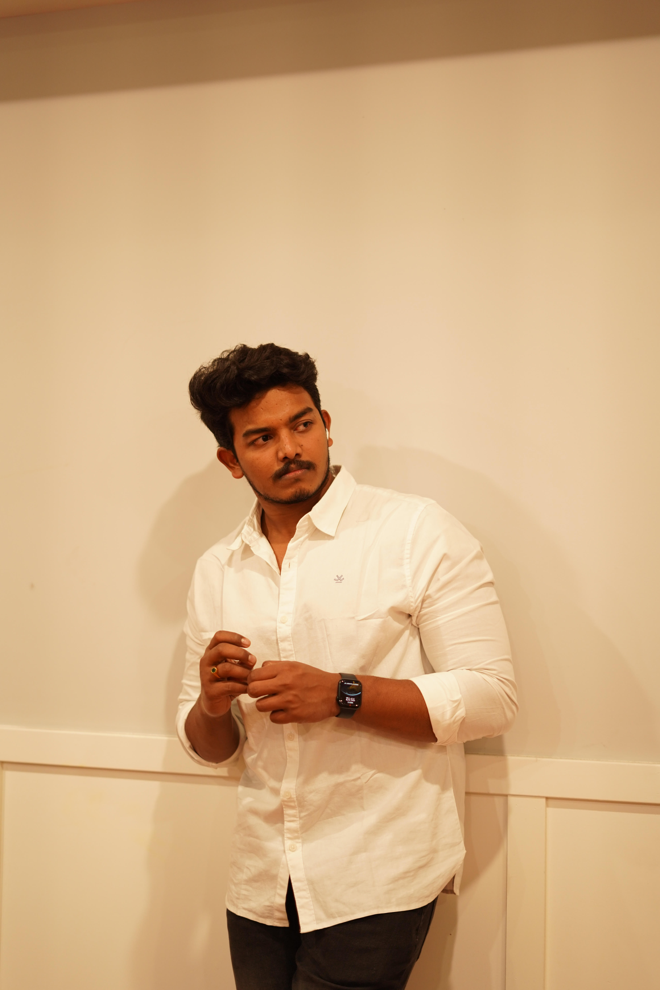

Reshma Gonu
(Developer)
Anusha Nunna
(Developer)
V
e
k
a
t
e
s
h
Alekhya
(Facilator)
Quality analyst

Slide 5

AGENDA

Slide 6

Overview of SARS-CoV-2 Detection Methods
Review of current SARS-CoV-2 detection methods (e.g. RT-PCR, antigen tests)
Limitations and challenges of current methods
Potential benefits of using AI for SARS-CoV-2 detection
Discussion of AI Techniques for SARS-CoV-2 Detection
Overview of AI techniques being used for SARS-CoV-2 detection (e.g. machine learning, deep learning)
Advantages and disadvantages of different AI techniques
Examples of successful applications of AI for SARS-CoV-2 detection
Data Collection and Preprocessing
Overview of data requirements for AI-based SARS-CoV-2 detection
Challenges in collecting and preprocessing SARS-CoV-2 data
Potential sources of data and strategies for overcoming data limitations

Slide 7
Model Development and Validation
Overview of model development and validation process
Discussion of different evaluation metrics for SARS-CoV-2 detection models
Considerations for model deployment and scalability

Slide 8

Ethical and Regulatory Considerations
Discussion of ethical and regulatory considerations related to AI-based SARS-CoV-2 detection
Privacy concerns related to data collection and sharing
Regulatory requirements for deploying AI-based SARS-CoV-2 detection systems

Slide 9

Next Steps and Future Directions
Summary of key takeaways from the meeting
Discussion of next steps for advancing AI-based SARS-CoV-2 detection
Ideas for future research and collaboration

Slide 10

PROJECT DESCRIPTION

Slide 11

The SARS-CoV-2 Detection through AI project aims to develop and validate artificial intelligence (AI) models for the detection of SARS-CoV-2 virus in patient samples. The project will explore different AI techniques such as machine learning and deep learning to develop models that can detect the virus accurately and efficiently.

Slide 12
The project team will collect and preprocess SARS-CoV-2 data from various sources such as public health databases and hospital records. The data will be used to train and validate AI models for the detection of SARS-CoV-2 from patient samples. The project will work closely with healthcare professionals, data scientists, and AI experts to ensure the development of reliable and accurate models.
The project will also investigate the ethical and regulatory considerations related to AI-based SARS-CoV-2 detection, such as privacy concerns related to data collection and sharing, and regulatory requirements for deploying AI-based SARS-CoV-2 detection systems.

Slide 13
The outcomes of this project will include the development of AI-based SARS-CoV-2 detection models that can be used in healthcare settings for early and accurate detection of the virus. The project will generate new insights into the potential of AI for SARS-CoV-2 detection and the ethical and regulatory considerations related to AI-based healthcare applications.
This project has the potential to significantly contribute to the global effort to control the COVID-19 pandemic by improving the accuracy and speed of SARS-CoV-2 detection, and could pave the way for the development of future AI-based healthcare applications.

Slide 14

personas

Slide 15
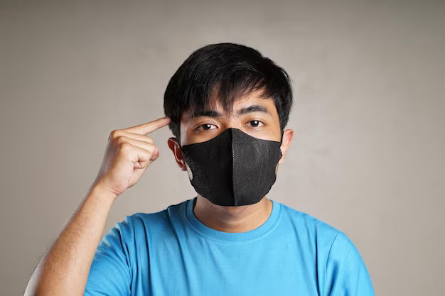
Anderson is a man and he is 26 years old. he went to the hospital to get checked out since he wasn't feeling very well, and the doctors wanted to see whether he was showing any signs of convulsions.
The CT scan was carried out, and the findings were gathered. Yet, none of the doctors are available to talk about the papers and provide their feedback. he is able to input the report into the program and obtain the findings by making use of the SARS Covid-19 Detection with AI technology.

Slide 16
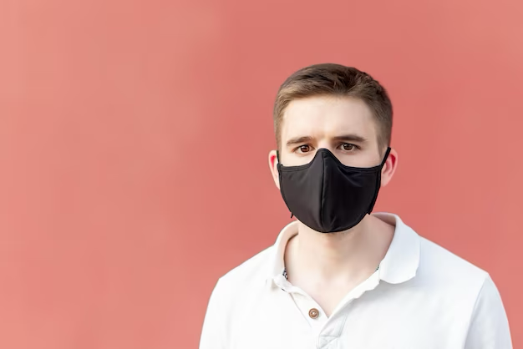
Alex is a man in his thirtieth year of life. Since he wasn't feeling well, he decided to get checked out at the hospital, where physicians looked for symptoms of convulsions.
It was determined that a CT scan was necessary, therefore one was performed. Not a single doctor can be reached for comment on the publications. he can use the SARS Covid-19 Detection utilizing AI technology to enter the report and acquire the results.

Slide 17
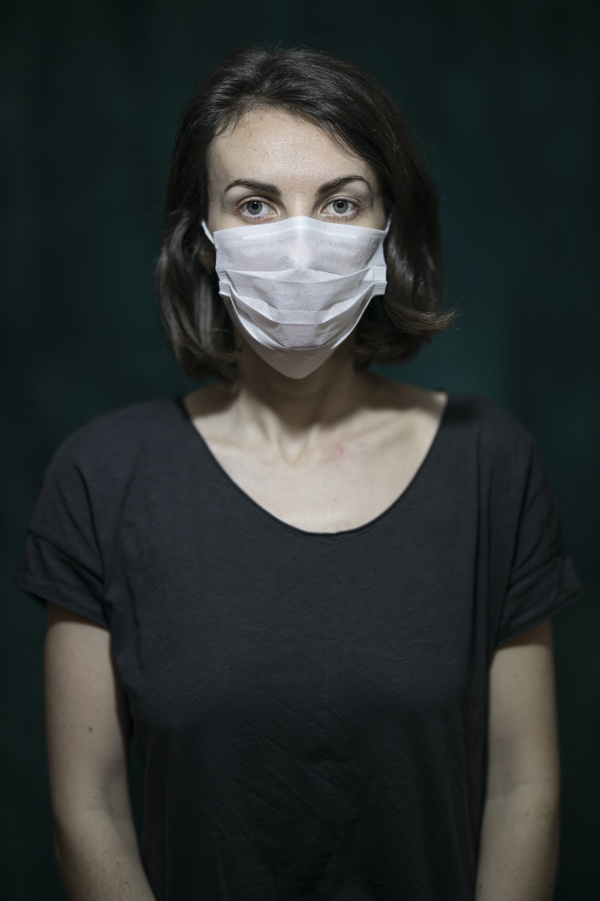
jackson is a woman and she is 42 years old. Because he is infected with Covid-19, it is important for him to take care of his health by consulting with physicians and obtaining some treatments.
Because to the effects of covid-19, he is unable to leave the house. She is able to discuss his condition with a chatbot that utilizes SARS Covid-19 Detection using AI, and receive recommendations from medical professionals.

Slide 18
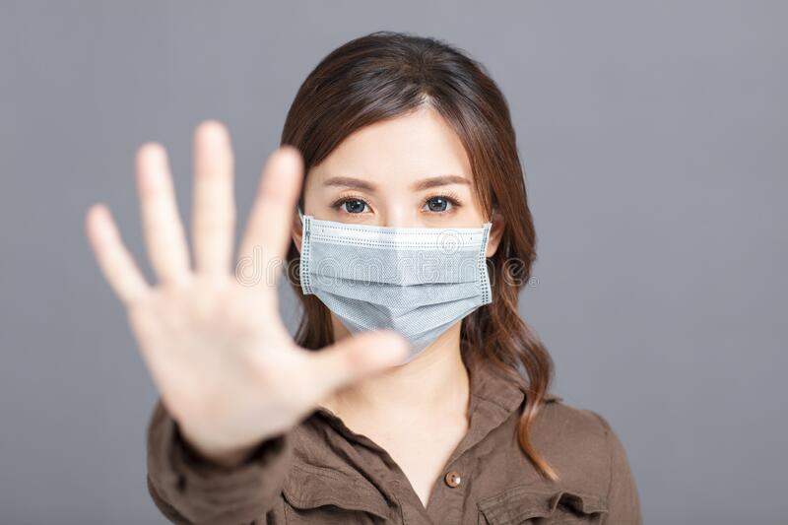
Olivia, a lady of 35 years old, is exhibiting signs of covid-19, but she is unsure whether or not she has the condition. So, she desires to test her own abilities. She has the ability to request a testing kits by utilizing the SARS Covid-19
Detection via AI. Because of her children, she is unable to reliably approach her infant child when he or she is experiencing symptoms.

Slide 19
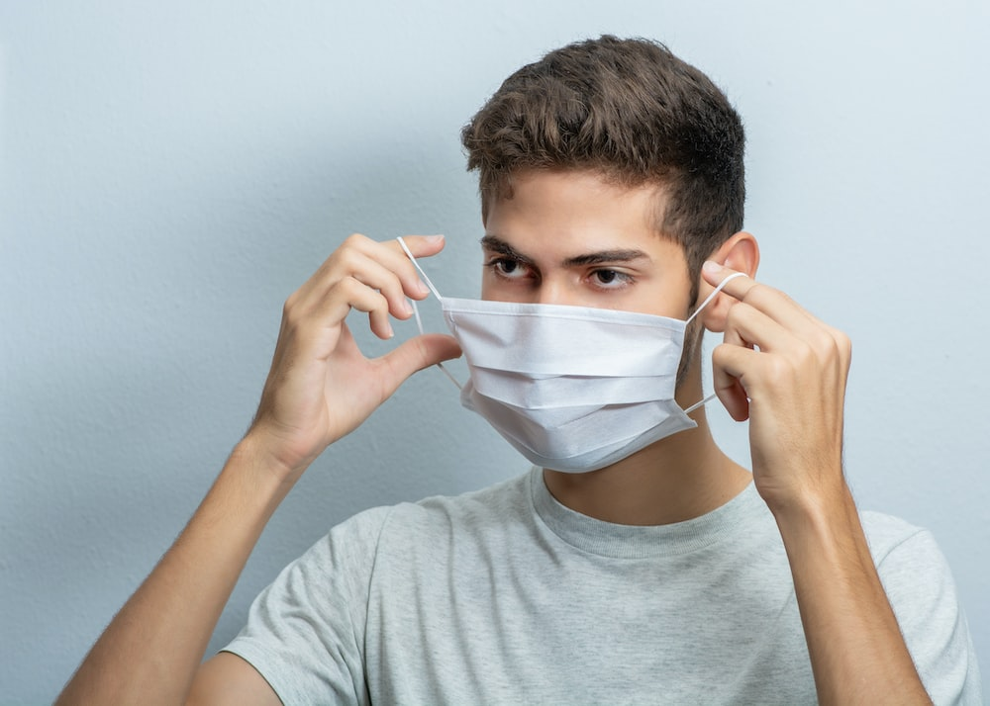
David is currently in the 18th year of his existence as a man. He went to the hospital to get weighed out because he hadn't been feeling very well, and the doctors there looked for signs of convulsions in him.
He is confined to the house and unable to go anywhere else because of the side effects of covid-19. he is able to discuss her husband's illness with a chatbot that employs SARS Covid-19 Detection utilizing AI, and in return, she will obtain advice from trained medical specialists.

Slide 20
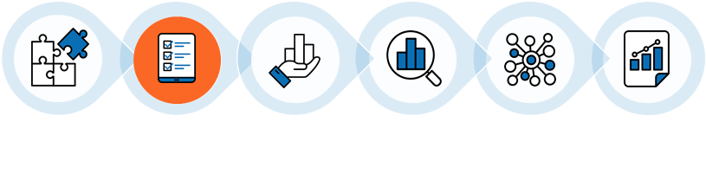
MVP(Minimum Viable Product)
MVP stands for Minimum Viable Product, which refers to the most basic version of a product that can be launched to test its viability in the market. In the context of COVID detection using AI, an MVP could include the following components:
Data collection: Collecting large datasets of COVID-19 positive and negative cases, along with relevant clinical and demographic information.
Data preprocessing: Cleaning, processing, and standardizing the collected data for use in machine learning models.
Feature selection: Identifying the most important features (such as symptoms, test results, and demographic data) that can be used to distinguish between COVID-19 positive and negative cases.

Slide 21
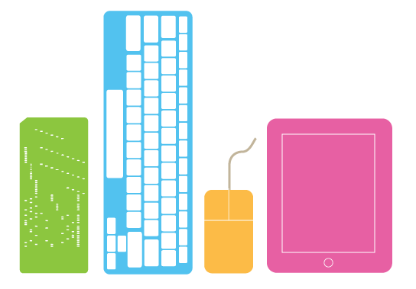
MVP(Minimum Viable Product)
Model selection: Choosing appropriate machine learning algorithms (such as logistic regression, decision trees, or neural networks) that can accurately classify COVID-19 cases based on the selected features.
Model training: Using the collected and preprocessed data to train the chosen machine learning model.
Model evaluation: Testing the performance of the trained model on a separate validation dataset to assess its accuracy, sensitivity, specificity, and other relevant metrics.
User interface: Creating a user-friendly interface for users to interact with the model, submit their data, and receive a prediction of their COVID-19 status. This MVP can serve as a starting point for developing more sophisticated AI-based COVID detection systems, which can be scaled up and refined based on user feedback and new data.

Slide 22
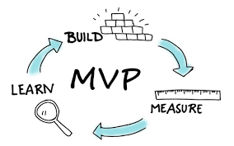
MVP(Minimum Viable Product)
Registration (sign up and log in )
Unique account
Home page
Services
Precautions
Appointment with doctor

Slide 23

MVP(Minimum Viable Product)
7) Scheduled confirmation
8) Tool kits
9) Medicines
10) Health tracking
11) Diet
12) Medical alarm

Slide 24

prototype

Slide 25
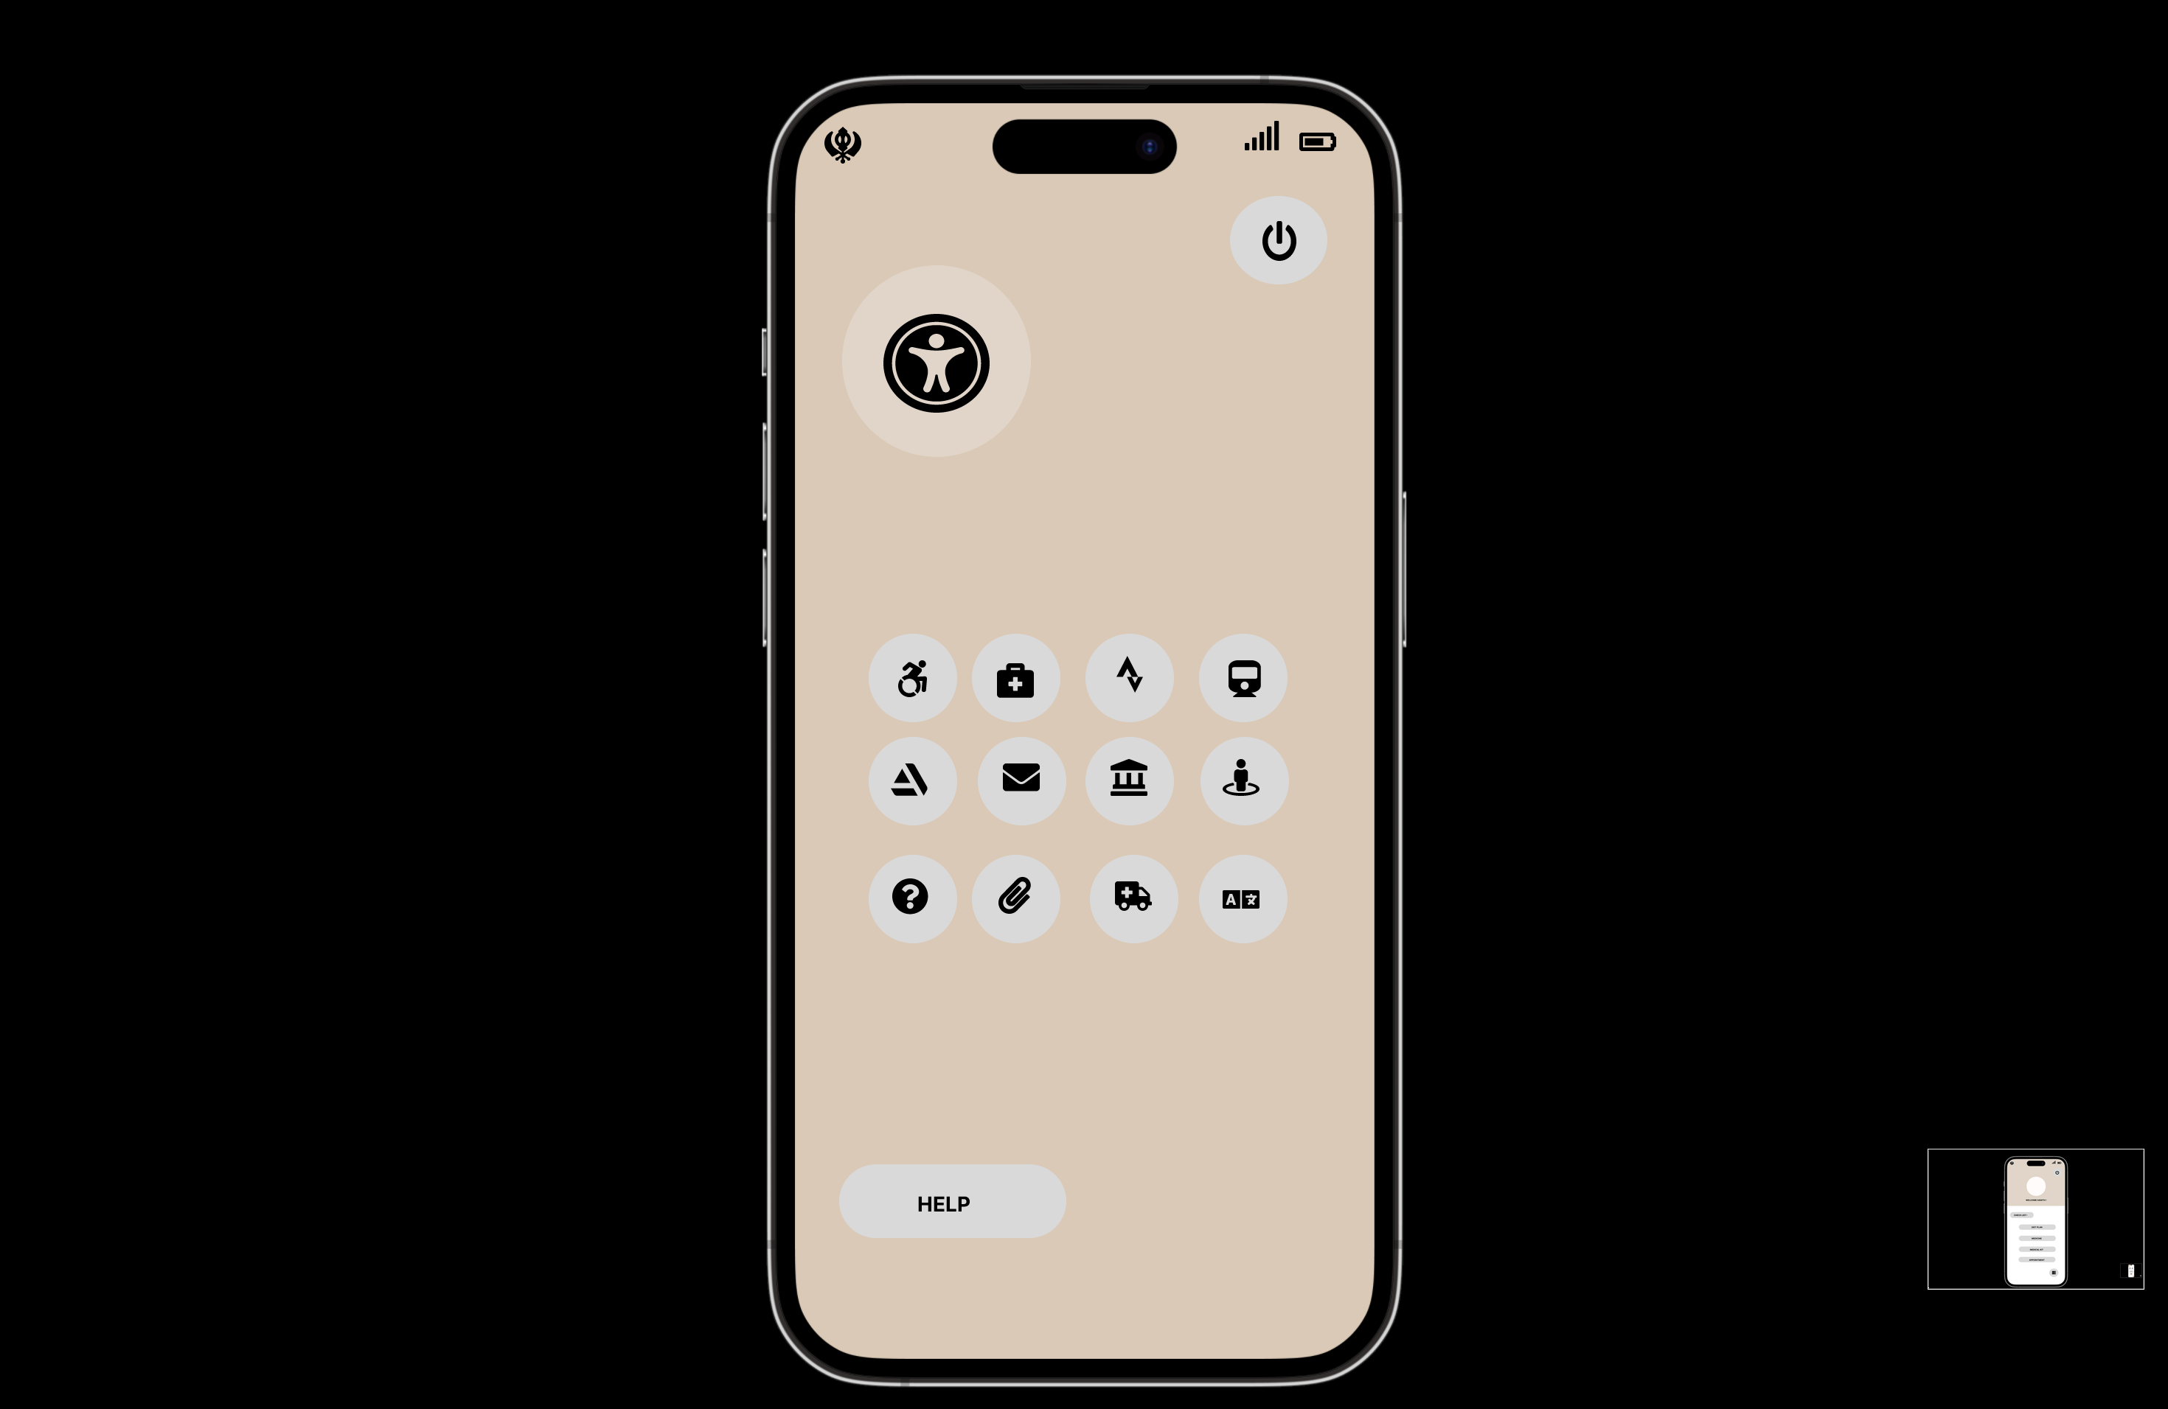
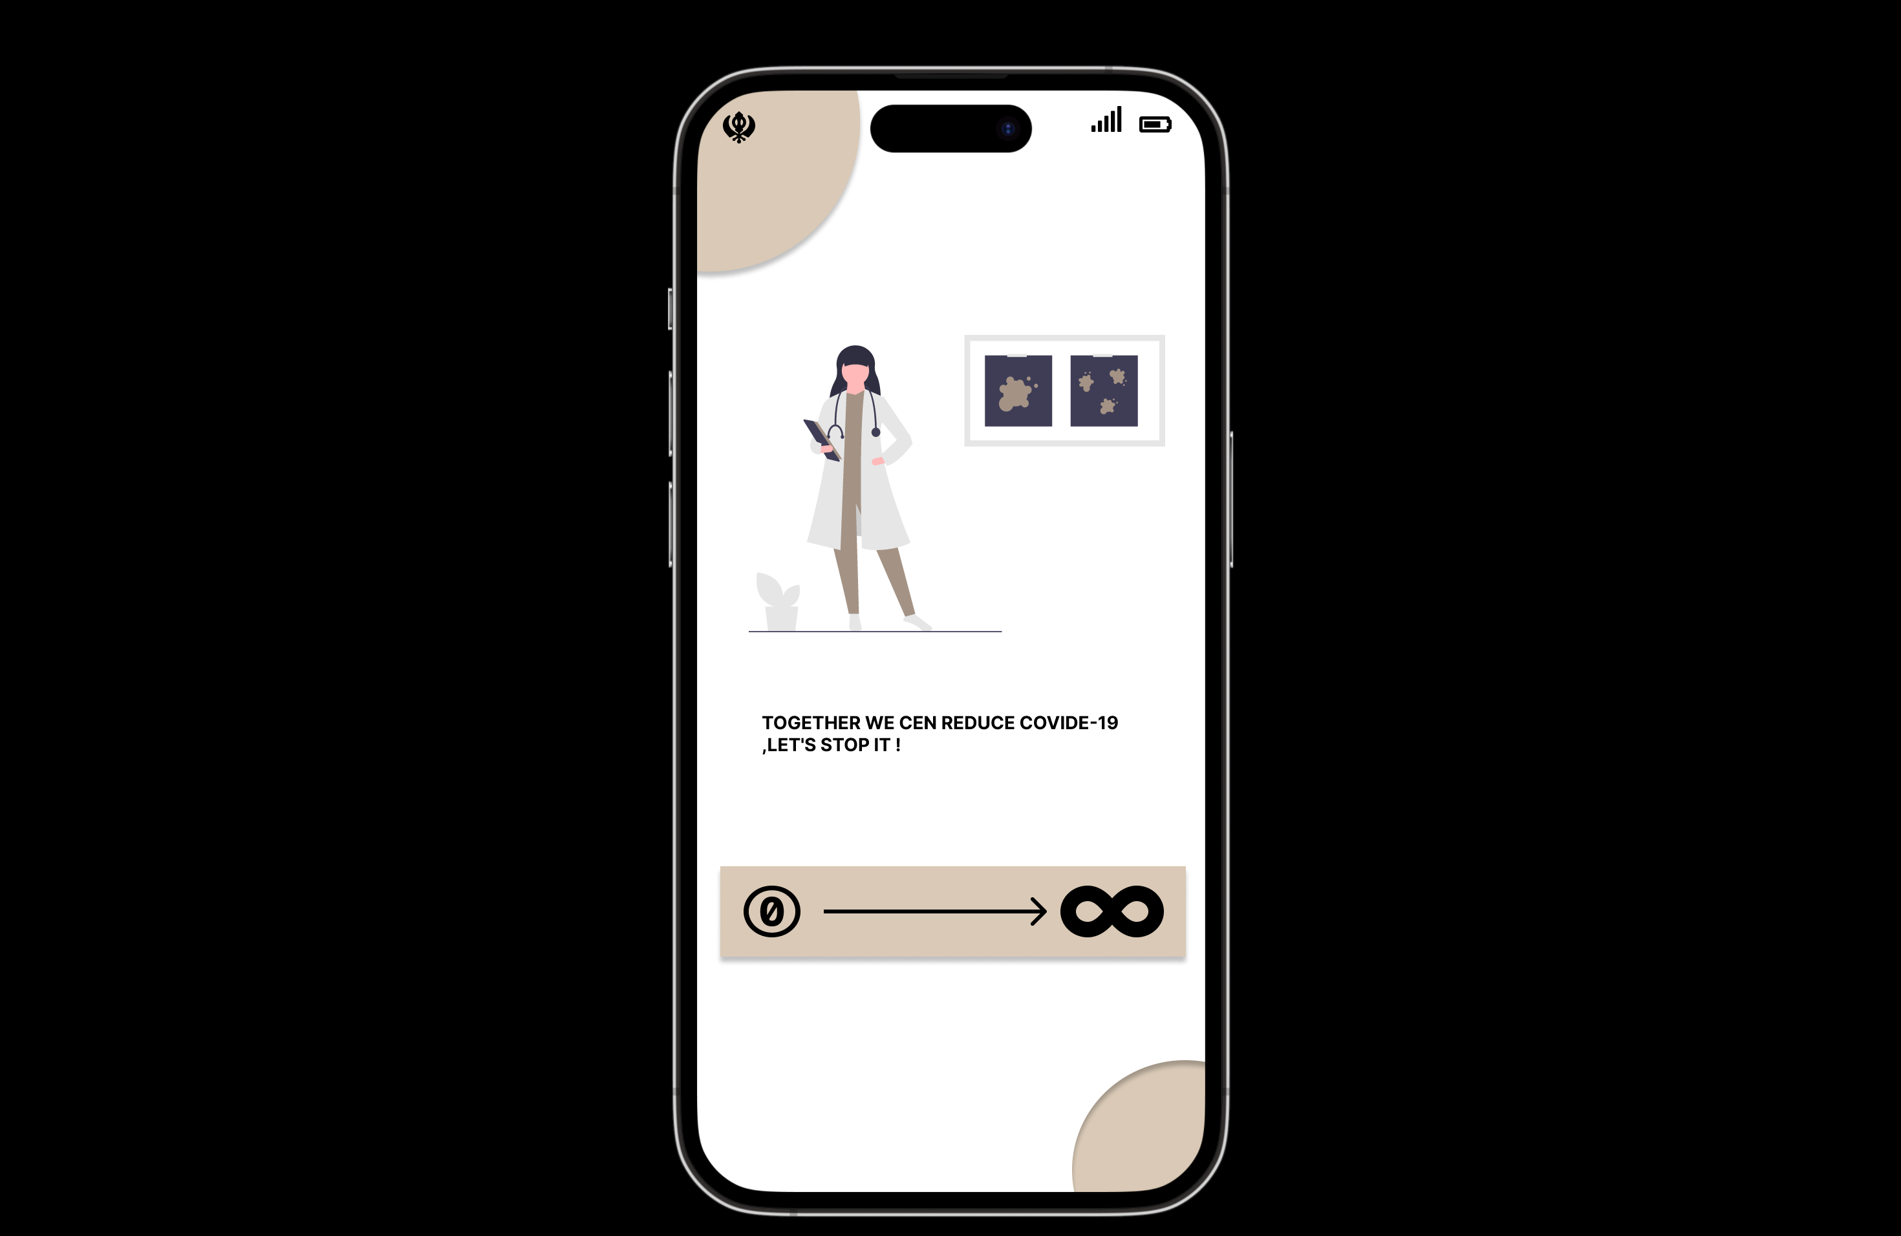
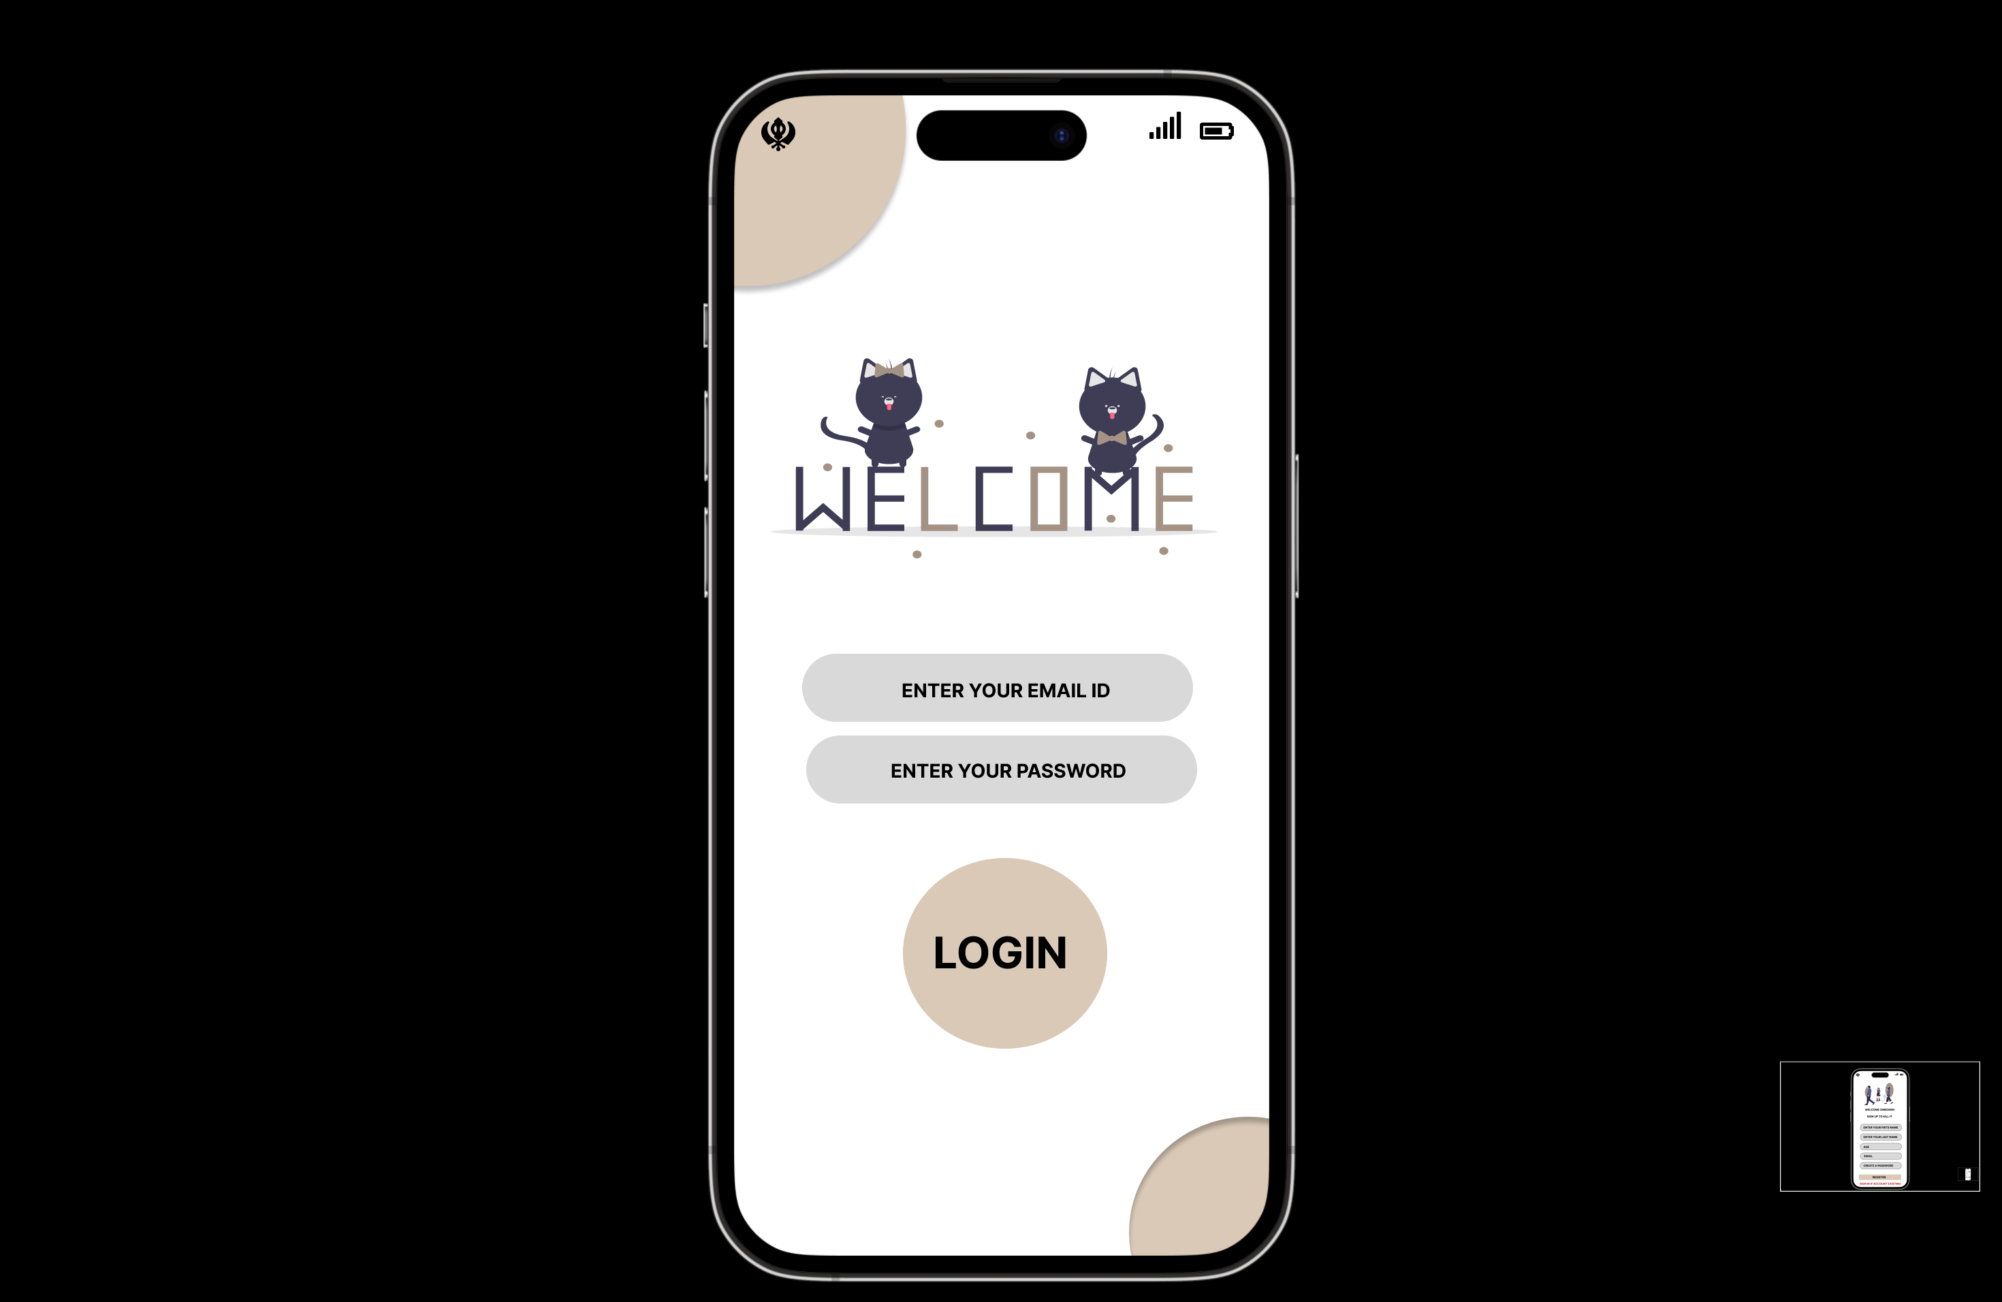
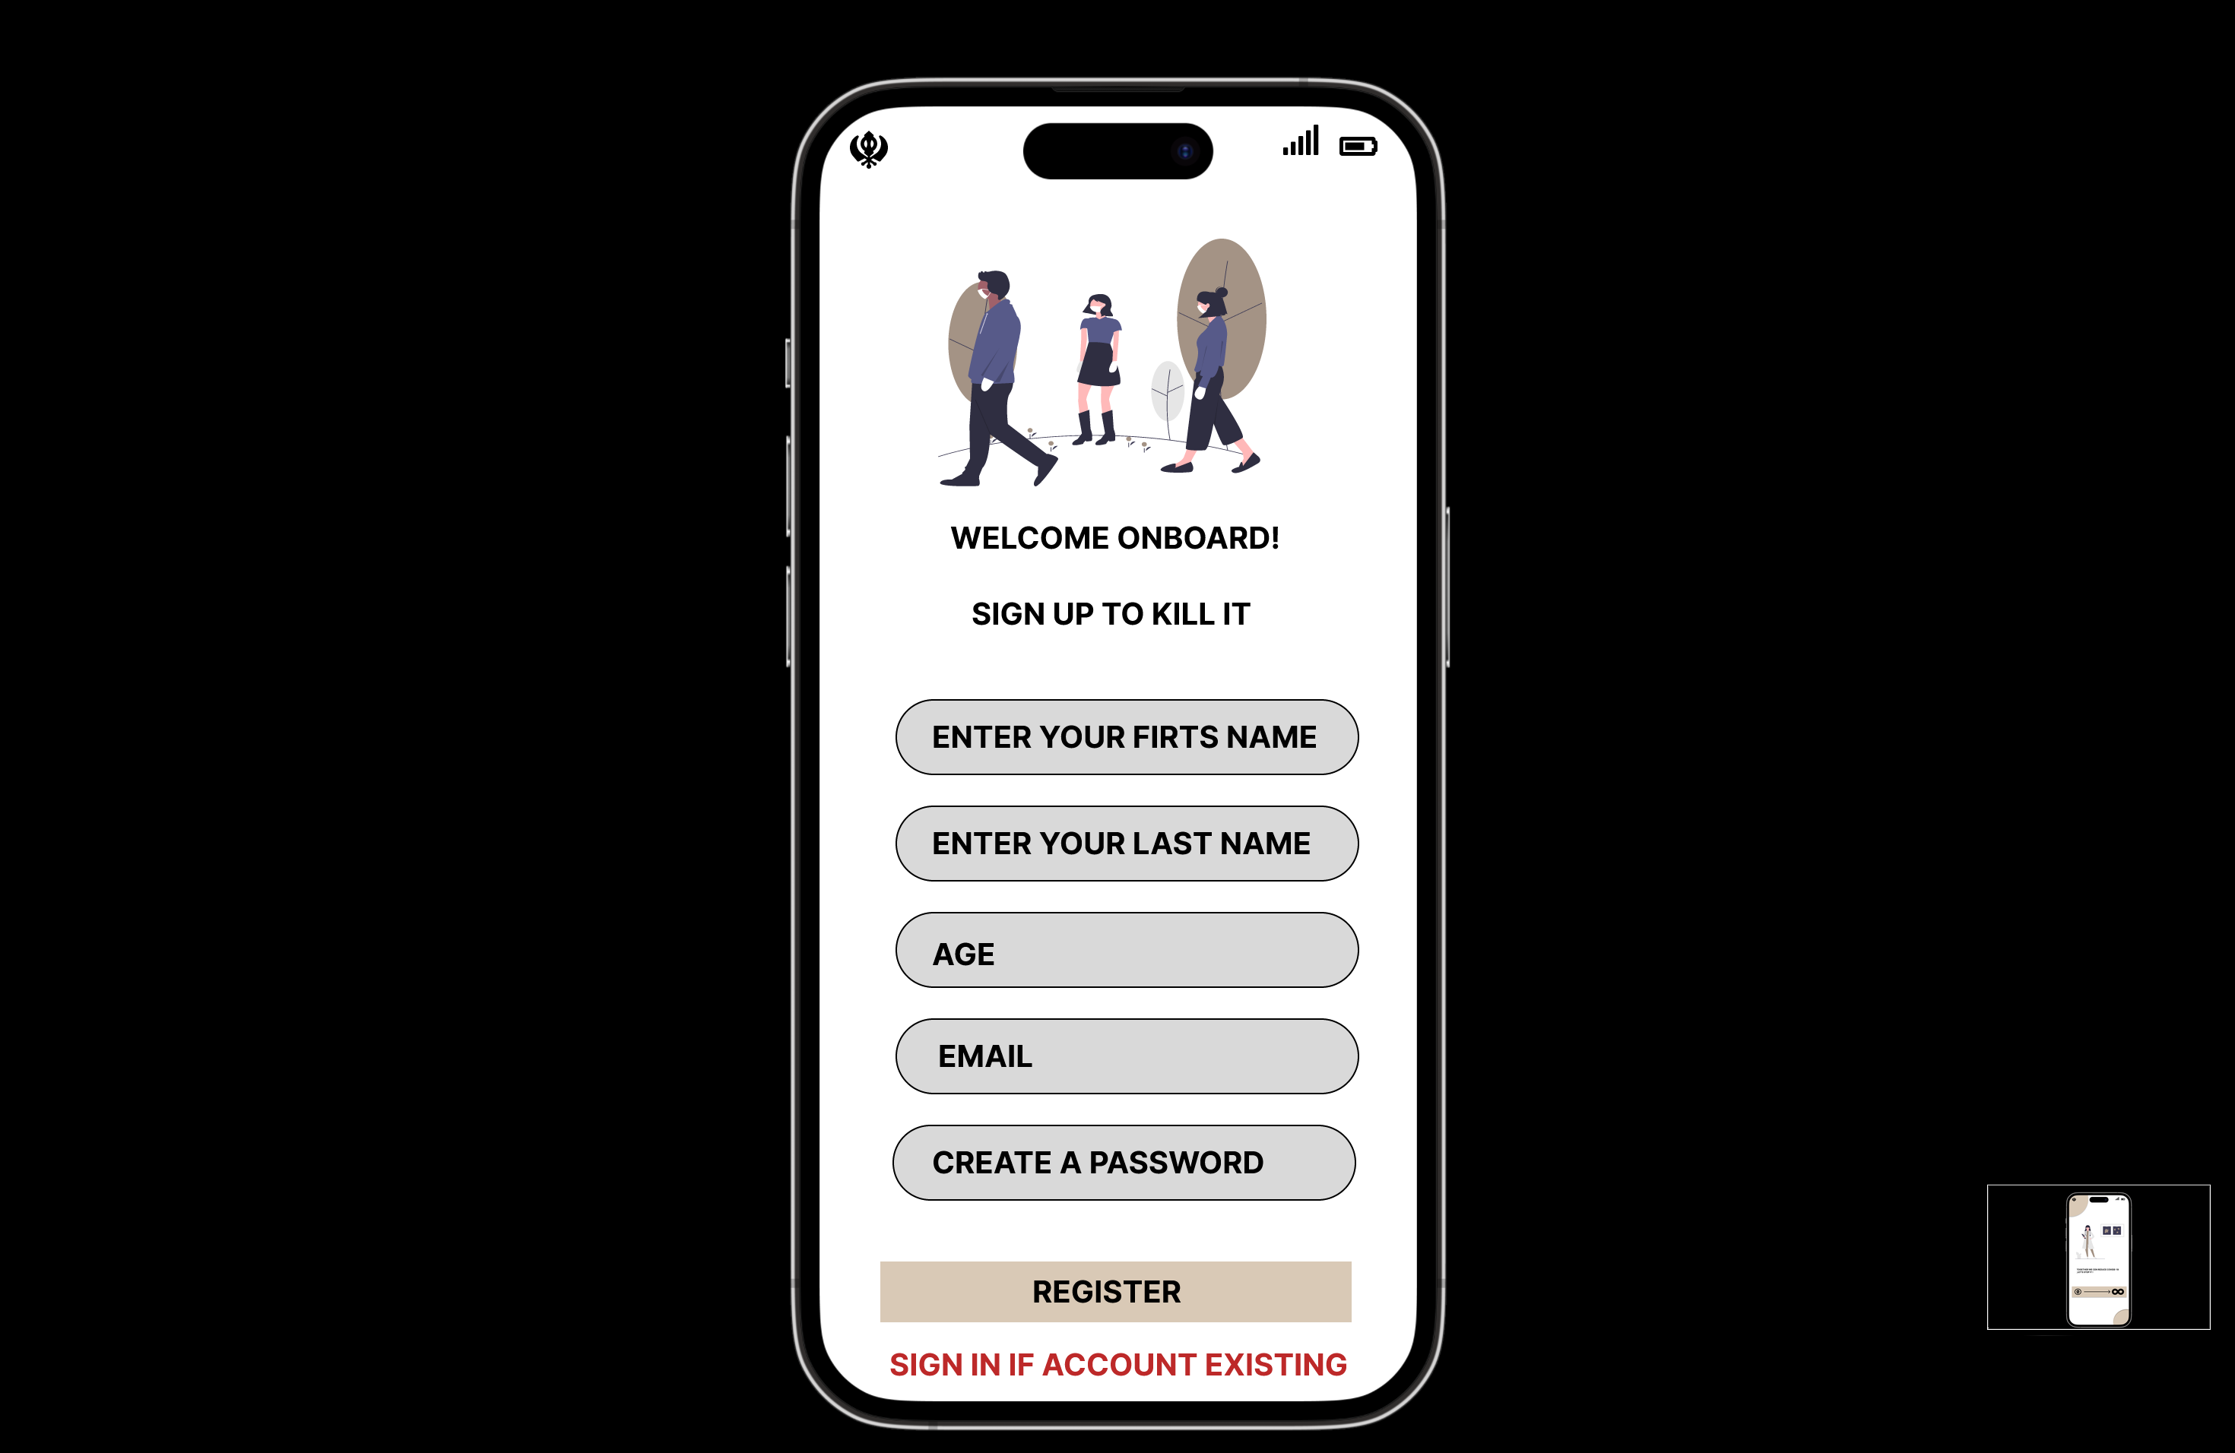
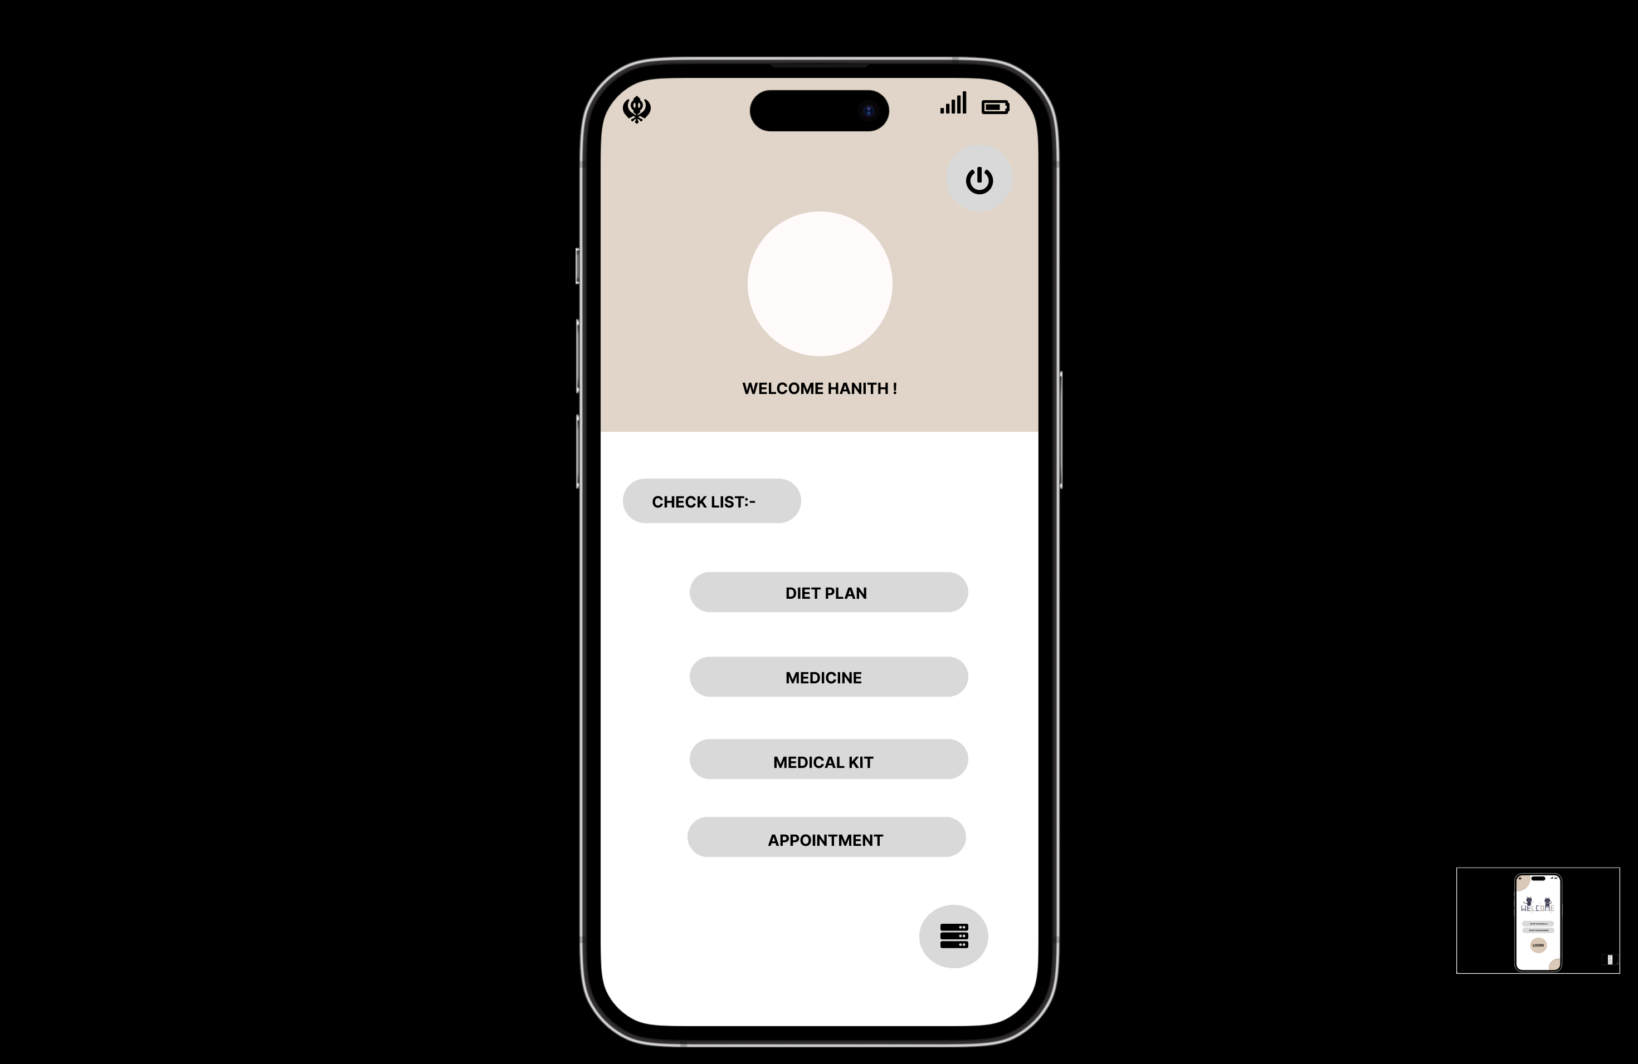
interface

Slide 26

ALGORITHMS
Source label
Source model
Source data
Target models
Target data
Target labels
Small amount of data
Large amount of data

Slide 27









Conceptual Architecture Diagram
Business Layer
Frontend
Backend
Client
Amazon Route 53
Data Layer

Slide 28
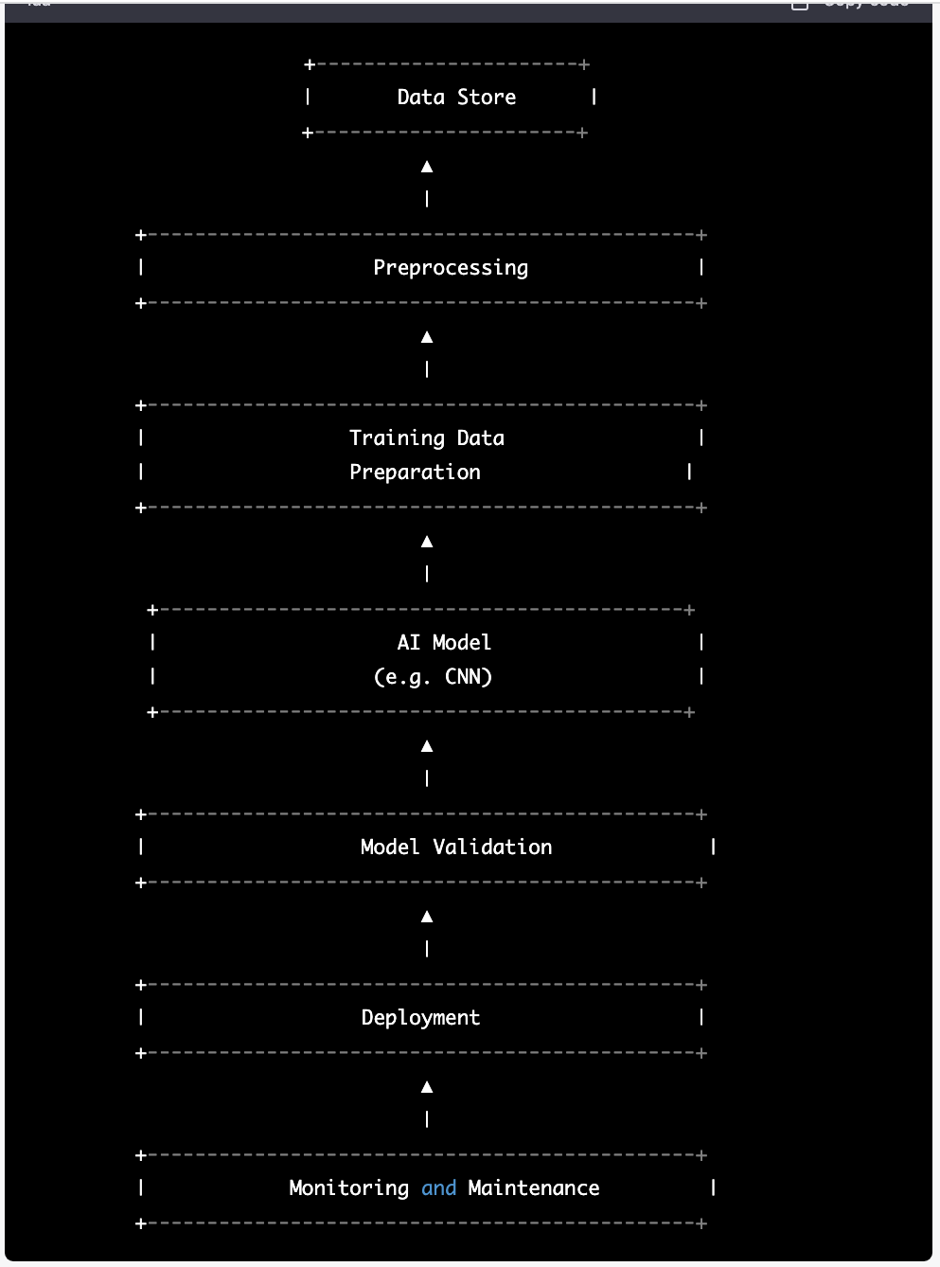
Flow chart

Slide 29
Sequence diagram

Slide 30








TECHNOLOGIES

Slide 31

User Stories
And
Acceptance
Criteria

Slide 32
User Stories & Acceptance Criteria
User Story ID | Summary | Status
SCIDTA-146 | As a User, I want to submit my test reports in the portal for evaluation from expert doctors so that I can get my current health status and inputs from doctor | Done
 | Scenario : Patient wants to upload their Test reports for assessment. Given I logged as Patient When I open the interface and browse upload documents page then I can an option for uploading the documents for various assessments and see the page to upload the test reports documents.
SCIDTA-148 | As a User, I want to request a kit in the portal that could be delivered to home. so that I can have assessment by myself and get inputs from experts by uploading them | Done
 | Scenario : user wants a testing kit to test by himself/herself Given I logged as User When I open the portal and go to testing kits page Then see all kind of testing kits available and I request required kit accordingly.
SCIDTA-154 | As a Trained medical specialist, I want to download the user reports from the portal and evaluate them so that I can provide inputs to the user | Done
 | Scenario : Medical specialist wants to download test reports Given I am in a role of logged-in Medical specialist When I open the web-page and go to test reports page Then I can find out all the test reports uploaded by users which are waiting for evaluation
SCIDTA-147 | As a Trained medical specialist, I want to upload users test results in the portal so that the user would be aware of his test results and act accordingly. | Done
 | Scenario : Trained medical specialist wants to upload test reports Given I'm in a role of Trained medical specialist When I open the web application and browse to upload results page then see all the pending reports tab and click on it and upload test results in portal.

Slide 33
User Stories Completed & Acceptance Criteria
User Story ID | Summary | Status
SCIDTA-12 | As a User, I want to discuss my/other health condition via chatbot so that I can inputs to be followed ( either from medical experts or AI Model) | To-do
 | Scenario : User wants to discuss their / other’s health condition and expect inputs in return. Given I logged as User When I open the interface and navigate to chatbot tool then I can shoot all my queries/ problems and see inputs or recommendations in return (either from AI model or Experts)
SCIDTA-150 | As a User, I want to register my self into the portal so that I can get upload documents , initiate discussion in chat bot, request kits etc.. | To-do
 | Scenario : User wants to register them self in the portal to use portal and its features. Given I logged as User When I open interface in need to register my self in the portal then I can access all the features available in the portal And utilize them whatever is needed
SCIDTA-151 | As a User, I want to have one more step for authentication factor like OTP , DUO , Authenticator so that I can secure my account from others | To-do
 | Scenario : User wants to have an additional step for authentication after login for securing his account. Given I logged as User When I open the interface and logged into the portal then I need to have one more step of authentication So that I can secure my accounts from unauthorized logins

Slide 34
Test Cases

Slide 35
Test Id | User story Id | Test Case | Current state | Test Data | steps to follow | Expected Result
TS-15 | SCIDTA-146 | browse uploads page | User logged into the portal | user details( Login details) | login->uploads section | users should get a new page where they can upload theirs test documents
TS-16 | SCIDTA-146 | select documents to upload | User logged into the portal | user details( Login details) | login->uploads section -> add docments | by clicking on add documents user should able to select the document he wanted to upload
TS-17 | SCIDTA-146 | Upload document ( submit ) | User logged into the portal | Document , user details ( login details) | login->uploads section -> upload-document | By clicking on submit user should able to submit his documents
TS-18 | SCIDTA-148 | browse testing kits page | User logged into the portal | user details( Login details) | login-> testing kits | users should get a new page where they can get list of available kits details
TS-19 | SCIDTA-148 | check kits availablity | User logged into the portal | user details( Login details) , testing kit details | login-> testing kits -> check availablity | User should get the availablity status of the selected kit/s

Slide 36
Test Id | User story Id | Test Case | Current state | Test Data | Steps to follow | Expected Result
TS-20 | SCIDTA-148 | Request Kit | User logged into the portal | user details( Login details) , testing kit details | login-> testing kits -> request kit | user should get the kit that they have selected to deliver
TS-21 | SCIDTA-154 | browse uploaded test results | Trained medical specialist logged into the portal | specialist login details | login -> uploads | Medical expert should get a page which shows all the documents that are uploaded and yet to evaluate
TS-22 | SCIDTA-154 | download test result/s | Trained medical specialist logged into the portal | specialist login details , document/s details | login -> uploads -> select document | Medical expert should be able to download the document/s
TS-23 | SCIDTA-12 | initiating chat bot - users/experts | User / Trained medical specialist logged into the portal | user / specialist login details | login-> chatbot | User / Trained medical specialist should get a chatbot interface where they can chat with other

Slide 37
Test Id | User story Id | Test Case | Current state | Test Data | steps to follow | Expected Result
TS-24 | SCIDTA-12 | initiate conversation - user | User logged into the portal | user details( Login details) , message | login -> chatbot -> start conversation | user should able to discuss his problem and get response in return from. Model / expert
TS-25 | SCIDTA-12 | initiate conversation - medical expert | Trained medical specialist logged into the portal | user / specialist login details , message | login -> chatbot -> start conversation | Medical expert should able the get the messages sent by user and revert back them with necessary information
TS-26 | SCIDTA-147 | browse and select documents to upload results | Trained medical specialist logged into the portal | specialist login details , document/s details | login -> uploads -> select document | Medical expert should get a new page and select all the uploads that he wanted to reply
TS-27 | SCIDTA-147 | Publish Test Feedback | Trained medical specialist logged into the portal | specialist login details , document/s details, Feedback | login -> uploads -> select document-> oublish | Medical expert should able to provide his feedback to uploaded documents

Slide 38
Test Id | User story Id | Test Case | Current state | Test Data | steps to follow | Expected Result
TS-28 | SCIDTA-150 | Register as user | User logged into the portal | user details( Login details) | Sign up | user should able to get a page which allows him to register himself in the portal
TS-29 | SCIDTA-150 | Browse signup page | User logged into the portal | User details | Sign up | User should get a page where they need to fill their personal information and register
TS-30 | SCIDTA-151 | Add Authentication factor | User logged into the portal | user details( Login details) , auth code | login -> verify | User should be navigated to a new page which ask him for auth code
TS-31 | SCIDTA-151 | Verify Authentication | User logged into the portal | user details( Login details) , auth code | login -> verify_code | User will enter his security code and proceed further

Slide 39
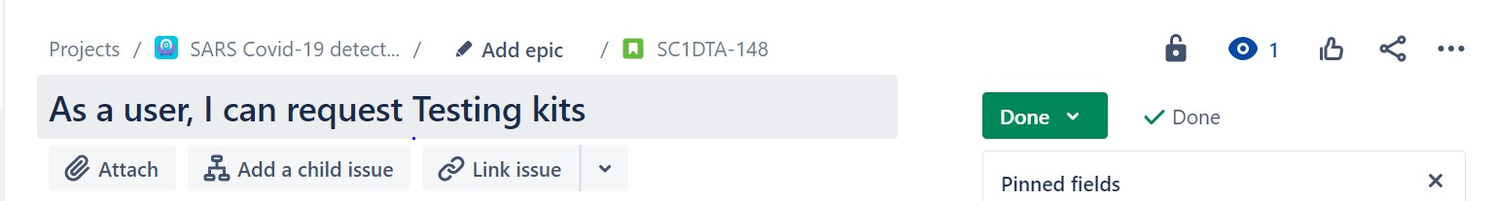
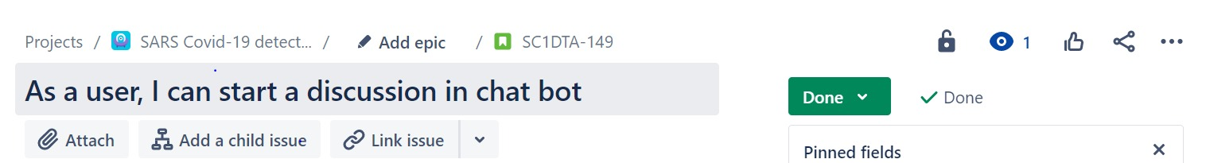
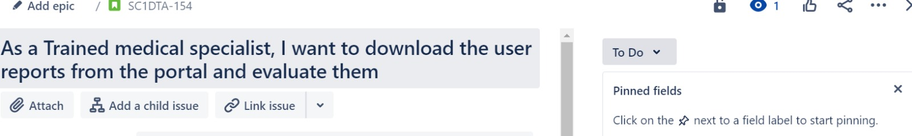
Stories Completed

Slide 40
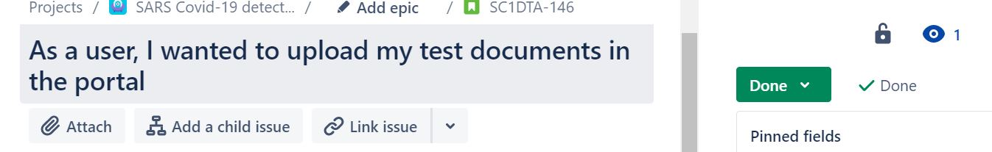
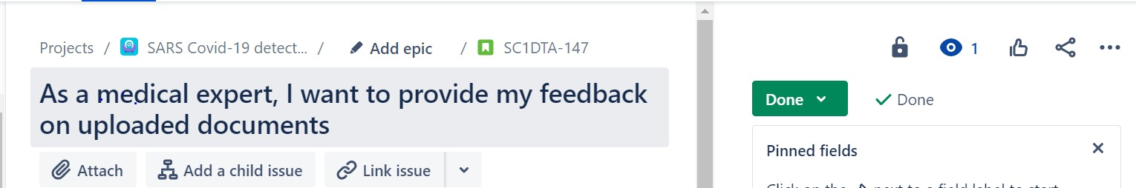
Stories Completed

Slide 41
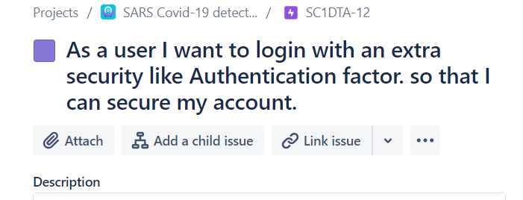
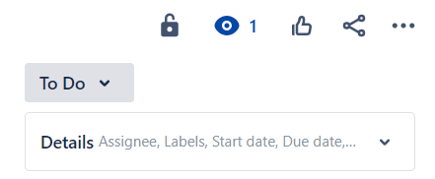
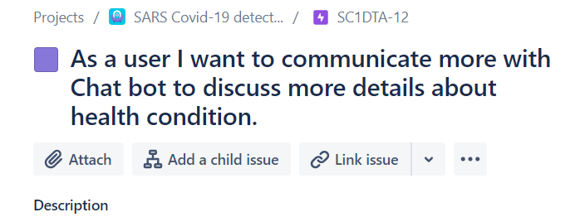
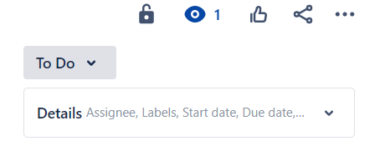
Stories Not Completed

Slide 42
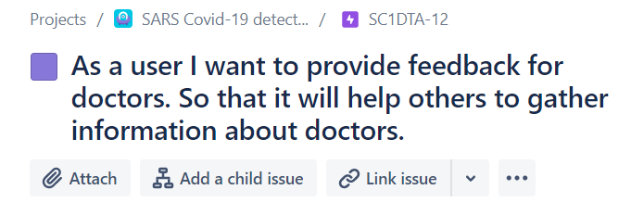
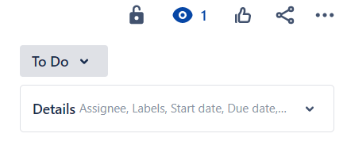
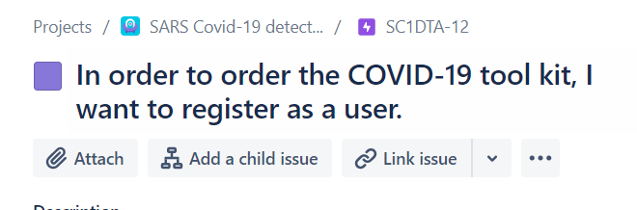
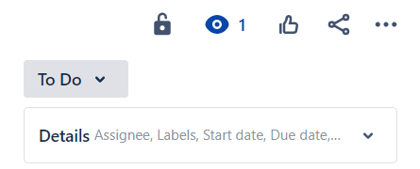
Stories Not Completed

Slide 43
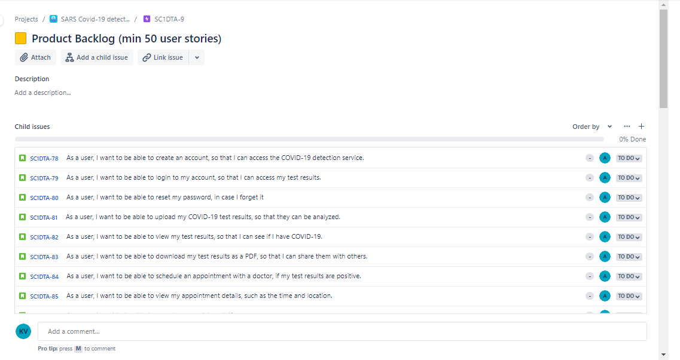
Product Backlog

Slide 44
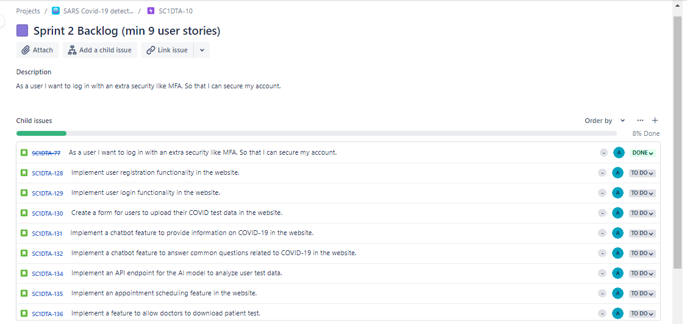
Sprint Backlog

Slide 45

Metrics

Slide 46
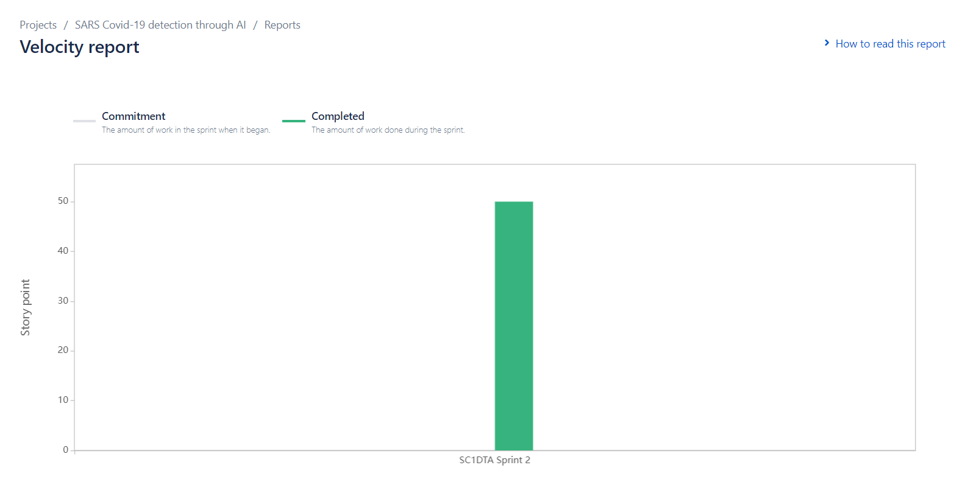
Team Velocity Report

Slide 47
Burndown chart

Slide 48
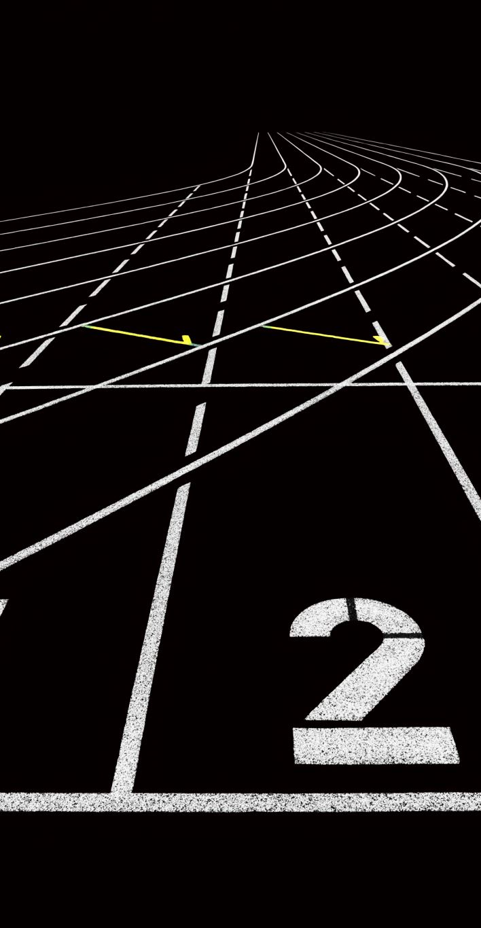
Completed/Committed Ratio
The story completion ratio is the percentage of the total no. of stories delivered in a sprint against the committed ones.
So, in this team we commits 24 user stories in a sprint and delivers 23, the story completion ratio will be 95%.
Story Completion Ratio = (Total No. of Stories Delivered / Total no. of Stories Committed) * 100

Slide 49

retrospective

Slide 50

What Went Well
Our team project went well overall, and one aspect of that was our efficient communication.
We made a point of keeping each other updated on our development.
We often met as a team to go over any problems or difficulties that might have arisen. As a result,
We were able to foresee possible issues early on and take action to remedy them before they turned into significant obstacles.
This made it possible for us to stay on schedule and deliver our finished product on time.

Slide 51
What can be improved
By more clearly outlining roles and duties, we could make our team project better.
Even though we all had a basic idea of what each individual was working on,
Some jobs either got missed or weren't finished since it wasn't clear who was in charge of them.
We could benefit from developing a more thorough project plan in the future that specifies exactly who is in charge of each task and when it is due.
This would make it easier for us to keep on track and make sure that all important chores are finished on time.
Also, it would increase team productivity by preventing miscommunication or duplication of effort.

Slide 52

Action We Take To Improve
To make sure that everyone is aware of their duties and responsibilities and is at ease with them,
The team could review and discuss this strategy. In addition,
We may arrange frequent team meetings to go over the status and identify any tasks that need to be finished.
We could change deadlines or reassign tasks as needed to keep the project on schedule.
By doing these things, we could increase the productivity and communication within our team and make sure that all important activities are finished quickly and efficiently.

Slide 53

Sprint-3

Slide 54
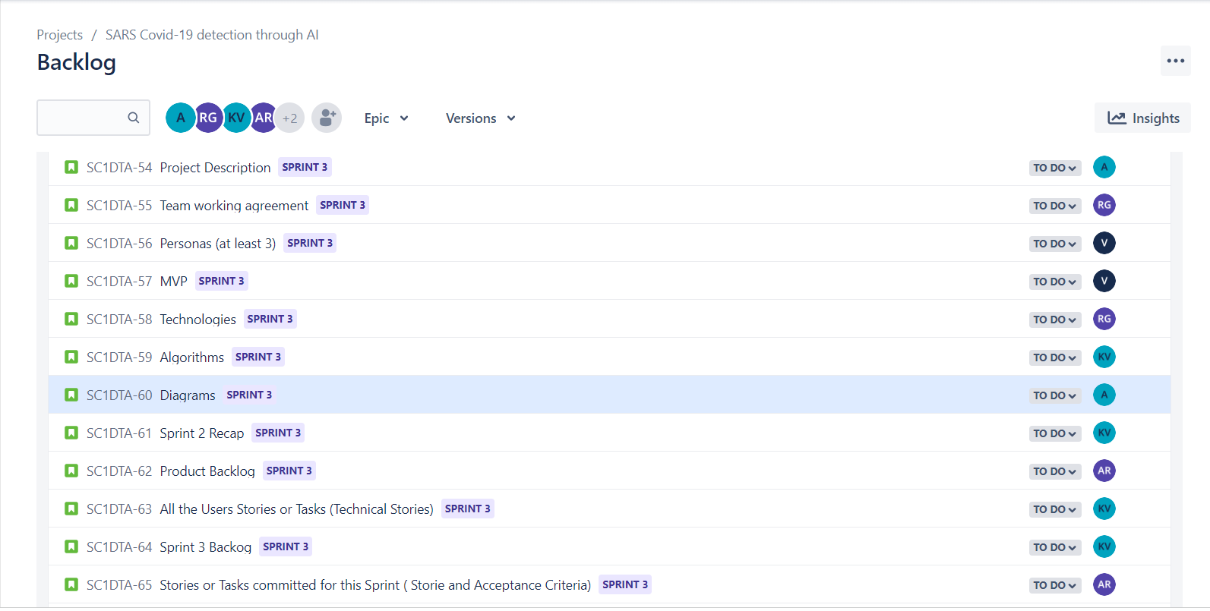
Sprint 3-Backlog

Slide 55

Improments made by professor feedback
1. personas
2.wiki page
3. cross checking very single aspect
4. taking care in quality of presentation

